Slide 1


Slide 2
Agenda
Tree based models
Hyperparameter
Clustering, Decision Tree - Notebook

Slide 3
Tree Based Models
Tree-based models use a series of if-then rules to generate predictions from one or more decision trees. All tree-based models can be used for either regression (predicting numerical values) or classification (predicting categorical values).
Decision tree models, which are the foundation of all tree-based models.
Random forest models, an “ensemble” method which builds many decision trees in parallel.
Gradient boosting models, an “ensemble” method which builds many decision trees sequentially.
Concept of Bagging and Boosting

Slide 4
Hyperparameter Tuning – WHY?
Let’s come back to Decision Trees Again!
Decision tree is a widely-used supervised learning algorithm which is suitable for both classification and regression tasks. Decision trees serve as building blocks for some prominent ensemble learning algorithms such as random forests, GBDT, and XGBOOST
Some of the features that make them highly efficient:
Easy to understand and interpret
Can handle both numerical and categorical data
Requires little or no preprocessing such as normalization or dummy encoding
Decision trees are prone to overfitting. They can easily become over-complex which prevents them from generalizing well to the structure in the dataset, Thus we tune Hyperparameters
Hyperparameters also define important properties such as its complexity or how fast it should learn

Slide 5
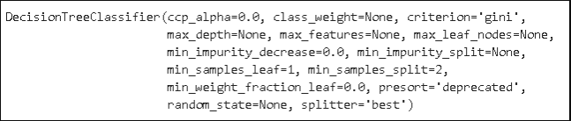
Hyperparameters in Decision Trees via Implementation
import numpy as np
import pandas as pd
from sklearn.datasets import load_wine
X, y = load_wine(return_X_y = True)
from sklearn import tree
clf = tree.DecisionTreeClassifier()
clf.fit(X, y)
import matplotlib.pyplot as plt
%matplotlib inline
plt.figure(figsize=(24,14))
tree.plot_tree(clf, filled=True, fontsize=14)
We will use one of the built-in datasets of scikit-learn. The wine dataset contains 13 features (i.e. columns) on three different wine classes. There are 178 samples (i.e. rows) in the dataset.
Decision tree classifier without any hyperparameter tuning.
All of the hyperparameters are set with the default settings. We can plot our model using plot_tree function
Notes:
# Necessary imports
from scipy.stats import randint
from sklearn.tree import DecisionTreeClassifier
from sklearn.model_selection import RandomizedSearchCV
# Creating the hyperparameter grid
param_dist = {"max_depth": [3, None],
"max_features": randint(1, 9),
"min_samples_leaf": randint(1, 9),
"criterion": ["gini", "entropy"]}
# Instantiating Decision Tree classifier
tree = DecisionTreeClassifier()
# Instantiating RandomizedSearchCV object
tree_cv = RandomizedSearchCV(tree, param_dist, cv = 5)
tree_cv.fit(X, y)
# Print the tuned parameters and score
print("Tuned Decision Tree Parameters: {}".format(tree_cv.best_params_))
print("Best score is {}".format(tree_cv.best_score_))
Output:
Tuned Decision Tree Parameters: {‘min_samples_leaf’: 5, ‘max_depth’: 3, ‘max_features’: 5, ‘criterion’: ‘gini’} Best score is 0.7265625

Slide 6
Hyperparameters in Decision Trees via Implementation
clf = tree.DecisionTreeClassifier(min_impurity_decrease=0.2)
clf.fit(X, y)
plt.figure(figsize=(18,10))
tree.plot_tree(clf, filled=True, fontsize=14)
clf = tree.DecisionTreeClassifier(max_depth=3)
clf.fit(X, y)
plt.figure(figsize=(20,10))
tree.plot_tree(clf, filled=True, fontsize=14)
clf = tree.DecisionTreeClassifier(max_depth=3,min_samples_leaf=3)
clf.fit(X, y)
plt.figure(figsize=(20,10))
tree.plot_tree(clf, filled=True, fontsize=14)
clf = tree.DecisionTreeClassifier(max_leaf_nodes=5)
clf.fit(X, y)
plt.figure(figsize=(20,10))
tree.plot_tree(clf, filled=True, fontsize=14)
When the algorithm performs a split, the main goal is to decrease impurity as much as possible. The more the impurity decreases, the more informative power that split gains. As the tree gets deeper, the amount of impurity decrease becomes lower. We can use this to prevent the tree from doing further splits. Hyperparameter name for this is : min_impurity_decrease. It will return a smaller tree as output when values are changed from default value of 0
Min_impurity_split parameter can be used to control the tree based on impurity values. It sets a threshold on gini. For instance, if min_impurity_split is set to 0.3, a node needs to have a gini value that is more then 0.3 to be further splitted. Another hyperparameter to control the depth of a tree is max_depth. It does not make any calculations regarding impurity or sample ratio. The model stops splitting when max_depth is reached.
min_samples_leaf, It indicates the minimum number of samples required to be at a leaf node. We need to be careful when using hyperparameters together.
We can also limit the number of leaf nodes using max_leaf_nodes parameter which grows the tree in best-first fashion until max_leaf_nodes reached. The best split is decided based on impurity decrease.
max_features which is the number of features to consider when looking for the best split

Slide 7
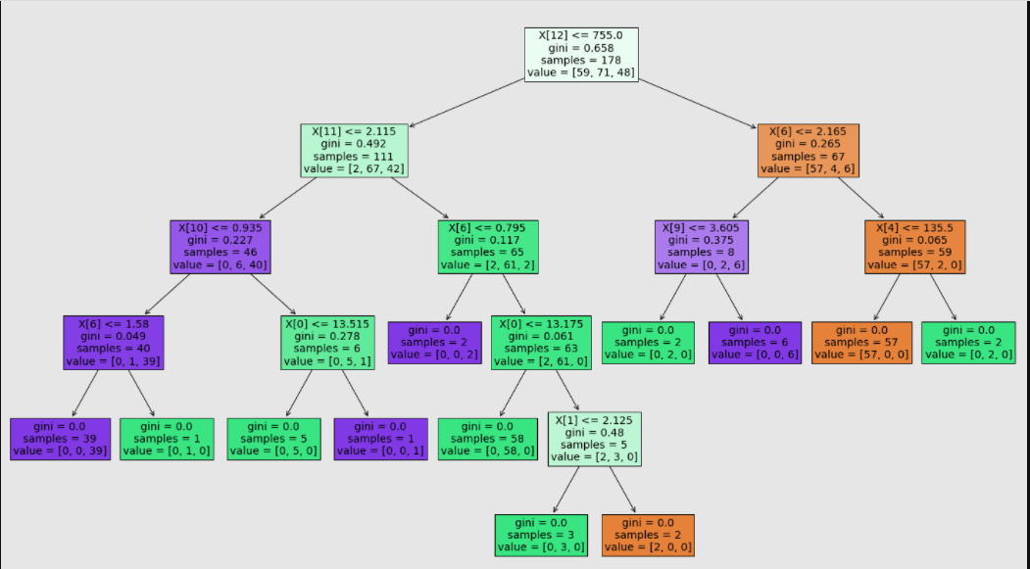
Hyperparameters in Decision Trees via Implementation
The model keeps splitting the nodes until all the nodes are pure (i.e. contain samples from only one class).
In each box:
The first line indicates the name of the feature (i.e. column) Since we did not name the columns, the index of the column is shown
Samples indicates the number of observations (i.e. rows)
Value shows the distribution of these samples according to the target variable.
Gini is a measure of impurity
Gini impurity is a measure of how often a randomly chosen element from the set would be incorrectly labeled if it was randomly labeled according to the distribution of labels in the subset. If you take a look the leaf nodes (the nodes at the end of tree), you will see that gini is equal to zero.
Notes:
Gini Index : For instance, let’s say we have a box with ten balls in it. If all the balls are same color, we have no randomness and impurity is zero. However, if we have 5 blue balls and 5 red balls, impurity is 1. If you take a look the leaf nodes (the nodes at the end of tree), you will see that gini is equal to zero.

Slide 8
Questions?

Slide 9
Thank You!

